Slide 1
IT Support Team Performance Using Analytics
Presented by
Shaik Farhana
Infosys Internship
2026

Slide 2
Project Objective
Analyze IT support ticket data
Identify performance issues
Improve resolution time
Increase customer satisfaction
Understand ticket trends and patterns
Analyze ticket priority and workload distribution
Provide data-driven insights for decision making
Optimize resource allocation
Enhance support team efficiency

Slide 3
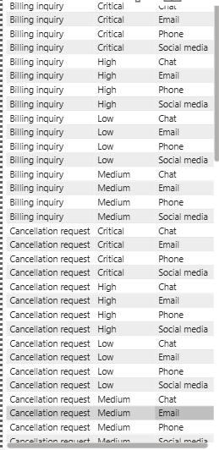
Dataset Description
Overview of IT Support Ticket Data
Ticket ID – Unique identifier for each ticket
Ticket Type – Type of issue (Billing, Technical, etc.)
Ticket Priority – High, Medium, Low, Critical
Ticket Channel – Email, Phone, Chat, Social Media
Resolution Duration – Time taken to resolve tickets
Customer Satisfaction – Rating given by customers

Slide 4
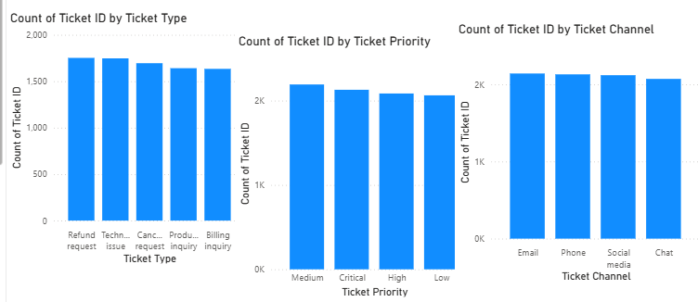
Exploratory Data Analysis
Ticket distribution across different categories is analyzed.
Billing and technical issues contribute significantly.
Medium and high priority tickets dominate the workload.
Email and phone channels handle the majority of tickets.
Provides insights into support team performance.

Slide 5
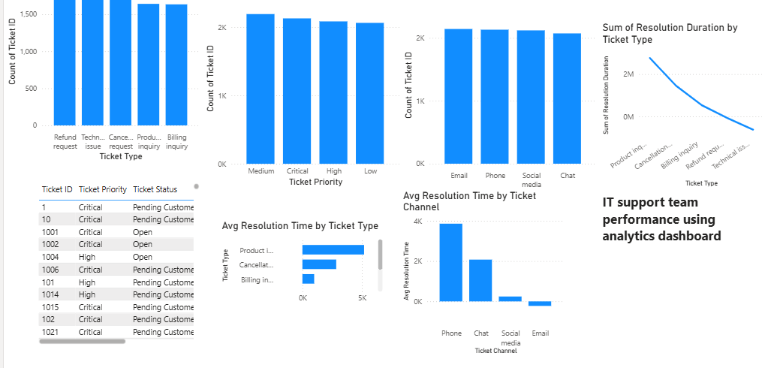
Dashboard Analysis
Resolution time varies across different ticket priorities.
High priority tickets require faster resolution.
Certain ticket types take longer time to resolve.
Average resolution time shows performance gaps.
Data helps identify areas for improvement.

Slide 6
Key Insights
High priority tickets require faster resolution but often take more time
Phone and chat channels handle the majority of support requests
Billing and technical issues are the most frequent ticket types
Resolution time varies significantly across ticket categories
Customer satisfaction is influenced by ticket priority and response time
Repeated issues indicate areas for process improvement
Email channel shows comparatively slower response times
Low priority tickets often experience longer resolution delays
Efficient ticket categorization helps improve overall support performance
These Insights helps improve decision making and support efficiency.

Slide 7
Tools & Technologies
📊 Power BI – Data visualization and dashboard creation
📁 Microsoft Excel – Dataset preparation
📈 Data Analysis – Extracting insights and patterns
🧹 Data Cleaning – Handling missing and inconsistent data
📊Data Visualization – Creating interactive charts and reports
🖥️ Dashboard Design – Building user-friendly dashboards
💡Data Interpretation – Understanding trends and patterns

Slide 8
Conclusion
This project demonstrates how data analytics improves IT support performance
High priority tickets require faster and more efficient resolution
Certain ticket types demand more time and resources
Communication channels like phone and email handle most requests
Data-driven decisions help improve efficiency and customer satisfaction
Overall, analytics enables smarter and faster IT support management

Slide 9
Thank You

